Slide 1

Artificial trainer
Eugene Lieberson (efl42)
Olivia Dang (oyd2)

Slide 2


WELCOME TO THE WORLD OF Pokémon!
Pokémon is a classic franchise published under Nintendo Corp. and owned by The Pokémon Company.
We, Eugene and Olivia, grew up playing Pokémon videogames on our GameBoy and Nintendo DS consoles.
The Pokémon world is one where trainers (humans) and their Pokémon compete side by side against others.

Slide 3
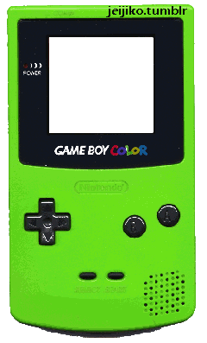
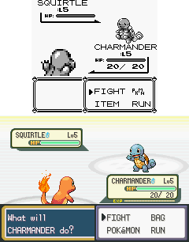
Pokémon generation I games
The first generation of Pokémon games were released in 1996: Pokémon Blue Version and Pokémon Red Version for GameBoy Color.
Our project is an artificially intelligent player of Pokémon Red.
We are using a GameBoy emulator.
Top: Generation I gameplay
Bottom: Generation III gameplay

Slide 4

The Pokémon game environment
A competitive, 2-agent environment
Each player takes back-and-forth turns
Can choose to attack, use item, or switch Pokémon
Partially observable: Our trainer only knows certain stats (more later)
Static: Deliberation in peace
Discrete: The GameBoy is a CPU!
Sequential

Slide 5

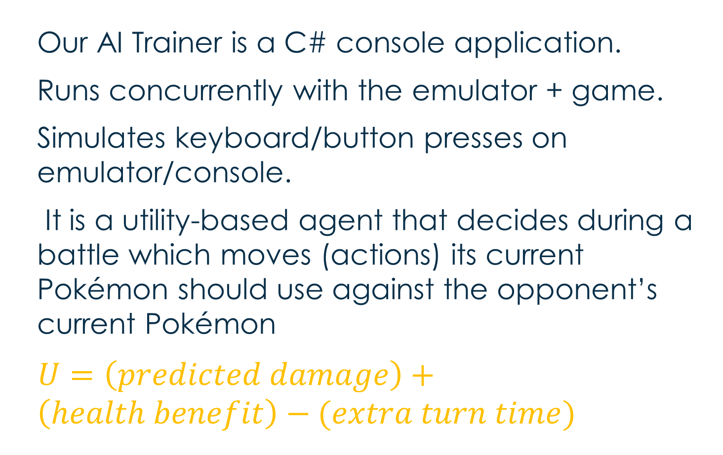
Our rational trainer
Our AI Trainer is a C# console application.
Runs concurrently with the emulator + game.
Simulates keyboard/button presses on emulator/console.
It is a utility-based agent that decides during a battle which moves (actions) its current Pokémon should use against the opponent’s current Pokémon
$U=\left(predicted damage\right)+\left(health benefit\right)−(extra turn time)$

Slide 6


Predicted damage: Variables to consider
Each Pokémon has one or two type(s).
Each Pokémon has attack, defense, and special stats.
Each Pokémon has an experience level.
Each Pokémon has a move set (maxsize = 4)
Each move has an attack power.
Each move has a type.

Slide 7
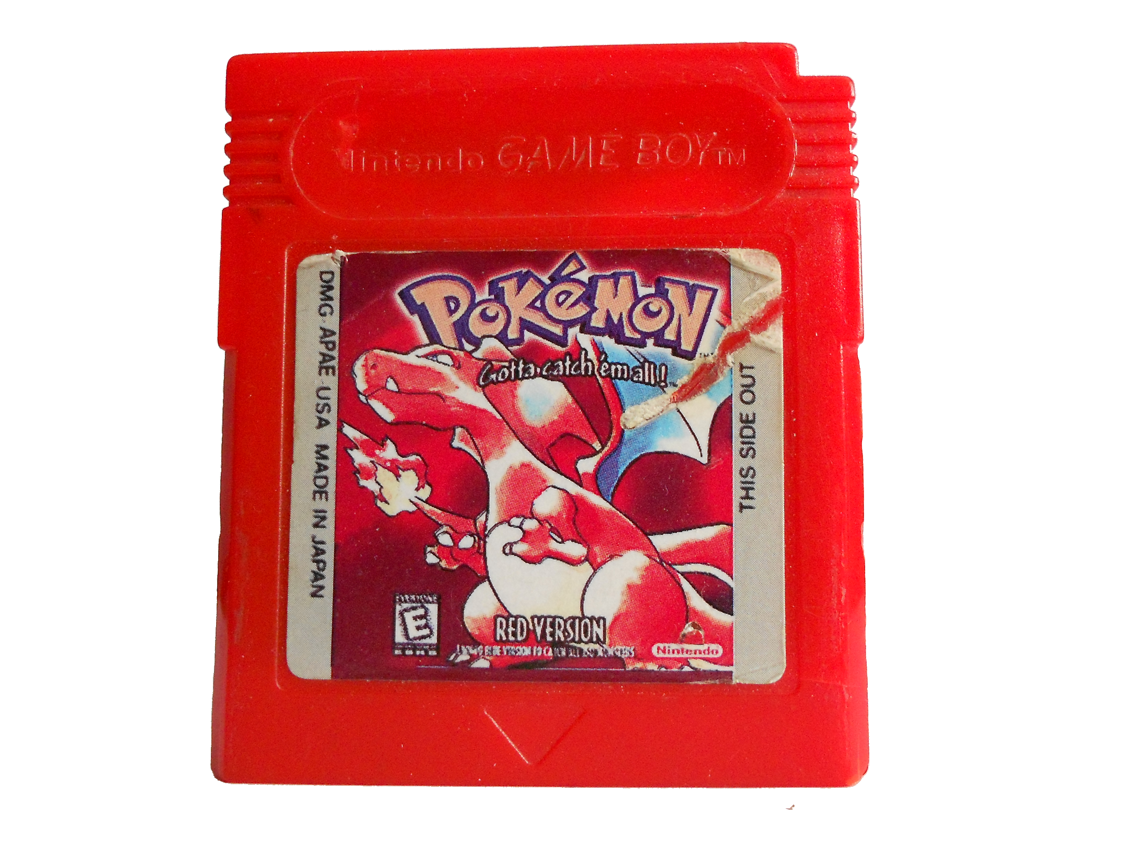
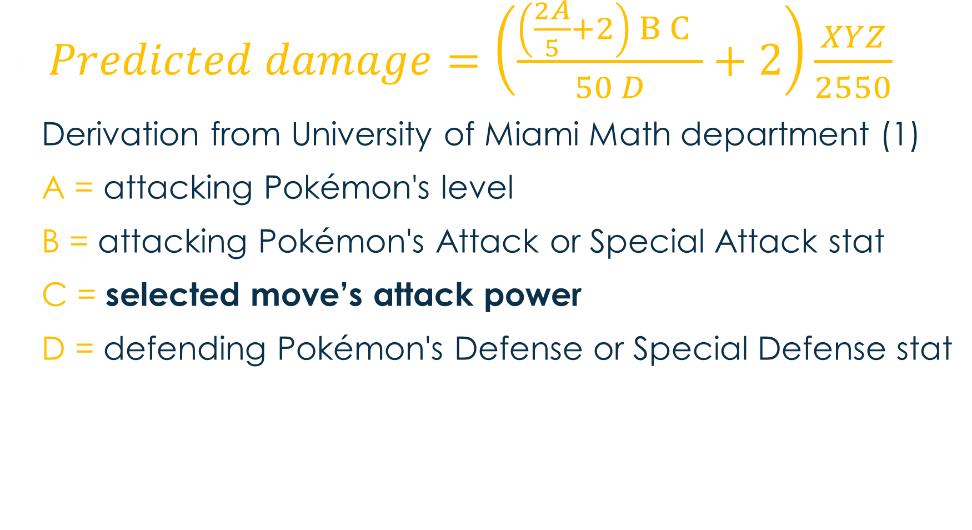
Predicted damage EQUATION
$Predicted damage=\left(\frac{\left(\frac{2A}{5}+2\right) B C }{50 D}+2\right)\frac{XYZ}{2550}$
Derivation from University of Miami Math department (1)
A = attacking Pokémon's level
B = attacking Pokémon's Attack or Special Attack stat
C = selected move’s attack power
D = defending Pokémon's Defense or Special Defense stat

Slide 8
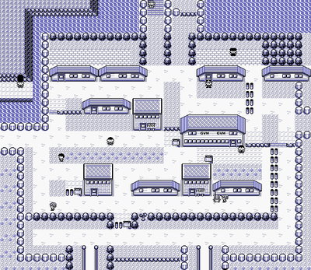
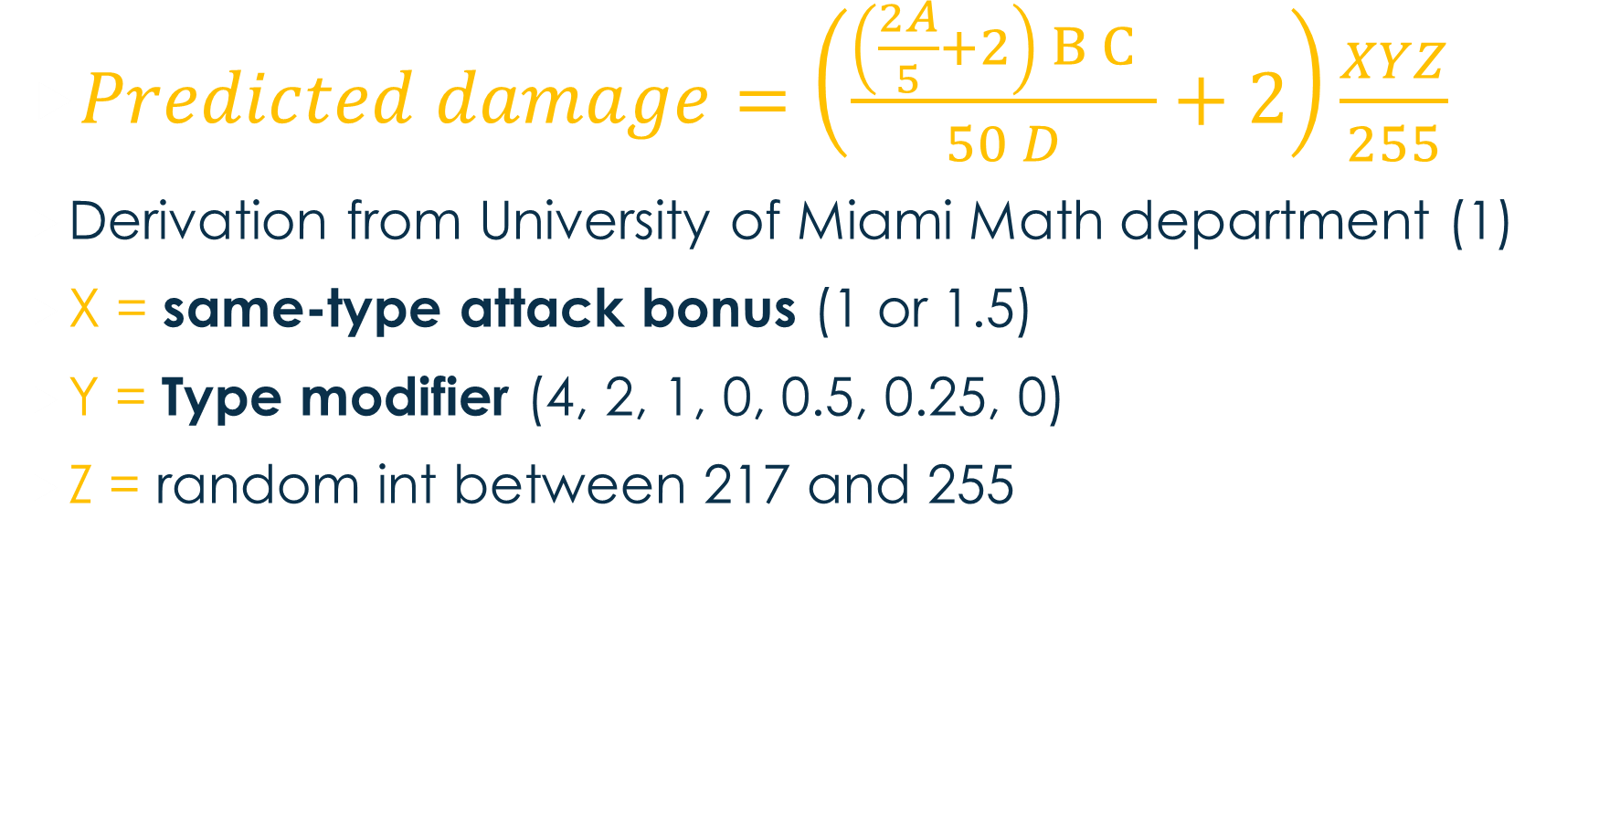
Predicted damage EQUATION
$Predicted damage=\left(\frac{\left(\frac{2A}{5}+2\right) B C }{50 D}+2\right)\frac{XYZ}{255}$
Derivation from University of Miami Math department (1)
X = same-type attack bonus (1 or 1.5)
Y = Type modifier (4, 2, 1, 0, 0.5, 0.25, 0)
Z = random int between 217 and 255

Slide 9
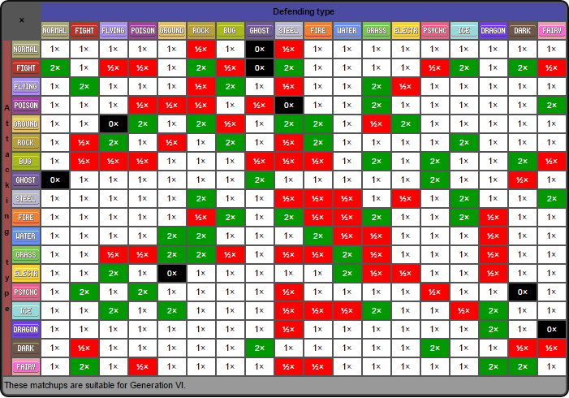
Type MODIFIERS CHART

Slide 10
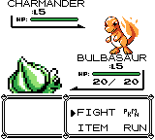
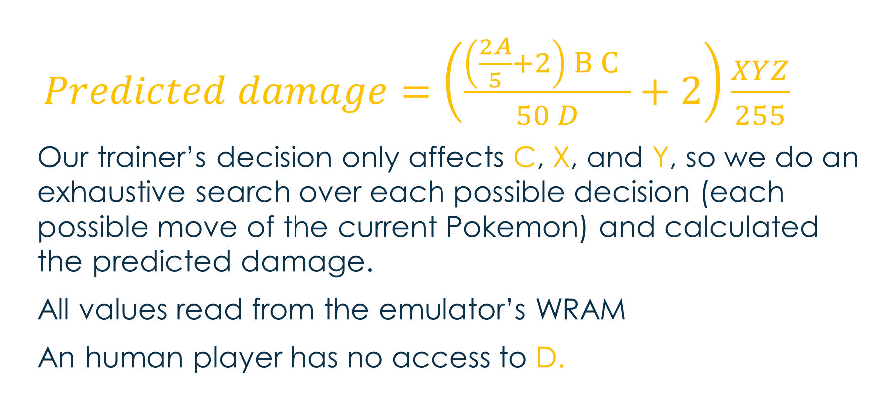
Predicted damage EQUATION
$Predicted damage=\left(\frac{\left(\frac{2A}{5}+2\right) B C }{50 D}+2\right)\frac{XYZ}{255}$
Our trainer’s decision only affects C, X, and Y, so we do an exhaustive search over each possible decision (each possible move of the current Pokemon) and calculated the predicted damage.
All values read from the emulator’s WRAM
An human player has no access to D.

